Slide 1
Clean Code

Slide 2
Agenda
What’s Clean
Clean Code

Slide 3
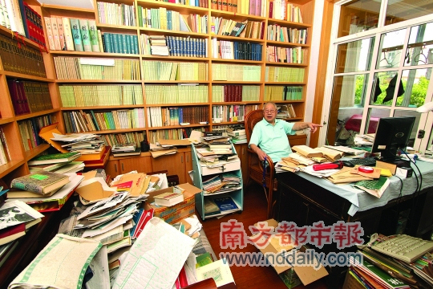
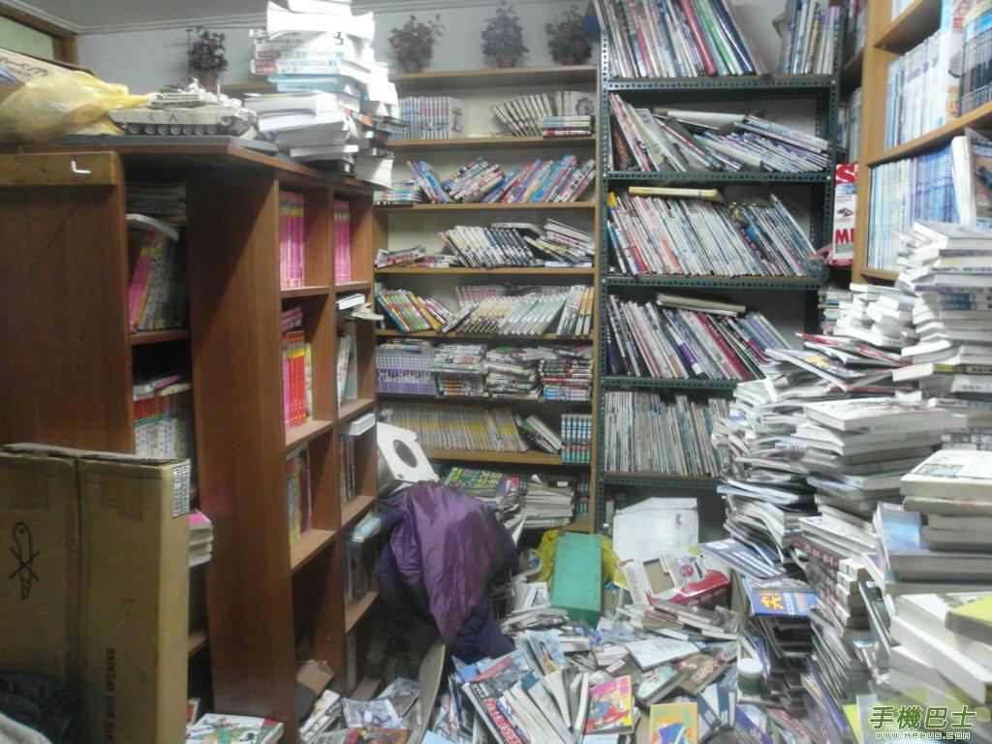
What’s the clean
Clean is everywhere

Slide 4
